Slide 1
Software Quality & Metrics

Slide 2
What Is Software Quality?
Quality must be defined and measured if improvement is to be achieved.
Quality not a single idea, but multidimensional concept.
Dimensions of quality include:
  entity of interest,
  viewpoint on that entity, &
  quality attributes of that entity.

Slide 3
Contd…
A popular view - it is an intangible trait
  It can be discussed, felt, and judged, but cannot be weighed or measured.
Crosby (1979) defines quality as "conformance to requirements" and
Juran and Gryna (1970) define it as "fitness for use."

Slide 4
Contd…
"Conformance to requirements" implies that requirements must be clearly stated such that they can’t be misunderstood.
In the development and production process, measurements are taken regularly to determine conformance to those requirements.
The non conformances are regarded as defects—the absence of quality.

Slide 5
Contd…
The "fitness for use" definition takes customers' requirements and expectations into account, which involve whether the products or services fit their uses.
Since different customers may use the products in different ways, it means that products must possess multiple elements of fitness for use.
The two most important parameters are:
  quality of design &
  quality of conformance.

Slide 6
Contd…
Quality of design in popular terminology is known as grades or models.
Quality of design can be regarded as the determination of requirements and specifications.
Quality of conformance is conformance to requirements i.e. the extent to which the product conforms to the intent of the design.

Slide 7
Contd…
From a customer's viewpoint, quality is the customer's perceived value of the product, based on a variety of variables such as price, performance, reliability, and satisfaction.

Slide 8
The Role of the Customer
To achieve the state of conformance to USER requirements:
  Customers' requirements gathered and analyzed
  Specifications to meet those requirements must be produced, &
  The product developed and manufactured accordingly.
In each phase of the process, errors can occur that will affect the quality of the finished product.
The requirements may be erroneous.
The development and manufacturing process may be subject to variables that induce defects, and so forth.

Slide 9
Developer & Customer
Customer's perspective - satisfaction after the purchase of the product is the ultimate validation that the product conforms to requirements and is fit to use.
Producer's perspective, once requirements are specified, developing and producing the product in accordance with the specifications is the path to achieving quality.

Slide 10
Quality Levels
Two levels q & Q
Intrinsic product quality, often operationally limited to the product's defect rate and reliability is "small q" (q for quality).
The broader definition of quality includes product quality, process quality, and customer satisfaction, and it is referred to as the "big Q."

Slide 11
IBM - CUPRIMDSO
IBM monitors satisfaction with its software products in levels of CUPRIMDSO:
  Capability [functionality],
  Usability,
  Performance,
  Reliability,
  Installability,
  Maintainability,
  Documentation/information,
  Service, and
  Overall

Slide 12
HP - FURPS
Hewlett-Packard focuses on FURPS:
  Functionality,
  Usability,
  Reliability,
  Performance &
  Serviceability

Slide 13
Contd…
To increase overall customer satisfaction:
  The quality attributes must be taken into account in the planning and design of the software.
  For example, the higher the functional complexity of the software, the harder it becomes to achieve maintainability.
15% or more of all software defects are requirements errors.

Slide 14
Quality Improvement
We need models of the development process, and within the process we need to select and deploy:
  specific methods & approaches &
  employ proper tools and technologies.
We need measures of the characteristics and quality parameters of the development process and its stages.
Metrics and models to ensure that the development process is under control and moving toward the product's quality objectives.

Slide 15
Total Quality Management
It represents a style of management aimed at achieving long-term success by linking quality and customer satisfaction.
In the computer and electronic industry, examples of successful TQM implementation include:
  Hewlett-Packard's Total Quality Control (TQC),
  Motorola's Six Sigma Strategy &
  IBM's Market Driven Quality.

Slide 16
Key elements of a TQM
Customer focus
  The objective is to achieve total customer satisfaction. Customer focus includes studying customers' wants and needs, gathering customers' requirements, and measuring and managing customers‘ satisfaction.
Process
  The objective is to reduce process variations and to achieve continuous process improvement. This element includes both the business process and the product development process.

Slide 17
Contd…
Human side of quality
  The objective is to create a companywide quality culture. Focus areas include leadership, management commitment, total participation, employee empowerment, and other social, psychological, and human factors.
Measurement and analysis:
  The objective is to drive continuous improvement in all quality parameters by the goal-oriented measurement system.

Slide 18
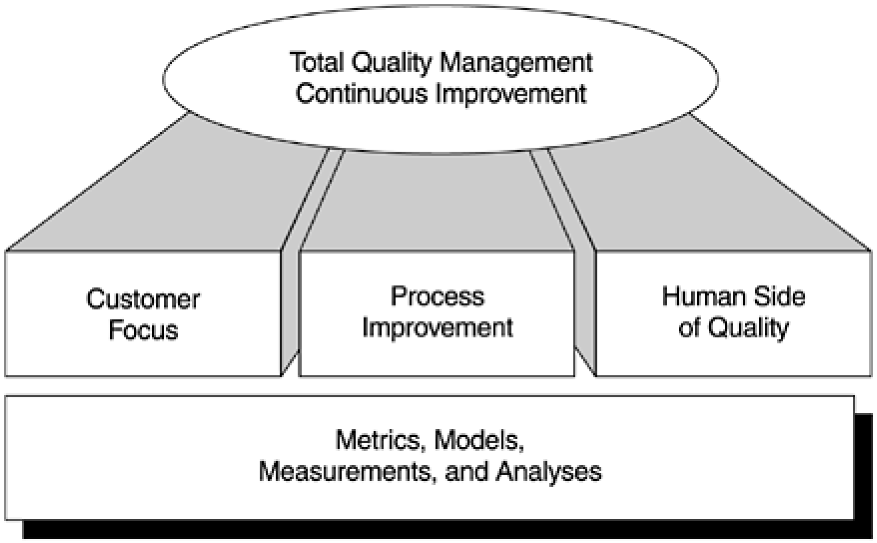

Slide 19
Quality Model
product
operation
revision
transition
reliability
efficiency
usability
maintainability
testability
portability
reusability
Metrics

Slide 20
Quality Metrics
Measures conformance to explicit requirements, following specified standards, satisfying implicit requirements.
Software quality can be difficult to measure and is often highly subjective.
Correctness:
The degree to which a program operates according to specification
  Metric = Defects per FP

Slide 21
Quality Metrics
Measures conformance to explicit requirements, following specified standards, satisfying of implicit requirements
Software quality can be difficult to measure and is often highly subjective
Correctness:
  The degree to which a program operates according to specification
  Metric = Defects per FP
Maintainability:
  The degree to which a program is amenable to change
  Metric = Mean Time to Change. Average time taken to analyze, design, implement and distribute a change

Slide 22
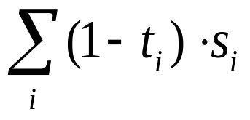
Quality Metrics: Further Measures
Integrity:
  The degree to which a program is impervious to outside attack
  Summed over all types of security attacks, i, where t = threat (probability that an attack of type i will occur within a given time) and s = security (probability that an attack of type i will be repelled)
Usability:
  The degree to which a program is easy to use.
  Metric = (1) the skill required to learn the system, (2) the time required to become moderately proficient, (3) the net increase in productivity, (4) assessment of the users attitude to the system

Slide 23
Quality Metrics: McCall’s Approach
Maintainability
Portability
Flexibility
Reusability
Testability
Interoperability
P
R
O
D
U
C
T
R
E
V
I
S
I
O
N
P
R
O
D
U
C
T
T
R
A
N
S
I
T
I
O
N
P
R
O
D
U
C
T
R
E
V
I
S
I
O
N
P
R
O
D
U
C
T
T
R
A
N
S
I
T
I
O
N
P
R
O
D
U
C
T
O
P
E
R
A
T
I
O
N
P
R
O
D
U
C
T
O
P
E
R
A
T
I
O
N
Correctness
Usability
Efficiency
Reliability
Integrity
McCall’s Triangle of Quality

Slide 24
Quality Metrics: Deriving McCall’s Quality Metrics
Assess a set of quality factors on a scale of 0 (low) to 10 (high)
Each of McCall’s Quality Metrics is a weighted sum of different quality factors
Example:
  Correctness = Completeness + Consistency + Traceability
  Completeness is the degree to which full implementation of required function has been achieved
  Consistency is the use of uniform design and documentation techniques
  Traceability is the ability to trace program components back to analysis
This technique depends on good objective evaluators because quality factor scores can be subjective

Slide 25
ISO 9126 Software Quality Factors
Functionality
  The degree to which the software satisfies stated needs
Reliability
  The amount of time that the software is available for use
Usability
  The degree to which the software is easy to use

Slide 26
ISO 9126 Software Quality Factors
Efficiency
  The degree to which the software makes optimal use of system resources
Maintainability
  The ease with which repair and enhancement may be made to the software
Portability
  The ease with which the software can be transposed from one environment to another

Slide 27
Quantitative Quality Model
Quality according to ISO 9126 standard
Divide-and conquer approach via “hierarchical quality model”
Leaves are simple metrics, measuring basic attributes
Functionality
Error tolerance
Reliability
Accuracy
defect density
Software
Efficiency
= #defects / size
Quality
Consistency
Usability
Simplicity
correction time
Maintainability
Modularity
correction impact
Portability
= #components
changed
ISO 9126
Factor
Characteristic
Metric

Slide 28
“Define your own” Quality Model
Define the quality model with the development team
Team chooses the characteristics, design principles, metrics ... and the thresholds
design class as an
number of private
abstract data-type
attributes ]2, 10[
Maintainability
Modularity
encapsulate all
number of public
attributes
attributes ]0, 0[
number of public
avoid complex
methods ]5, 30[
interfaces
average number of
arguments [0, 4[
Factor
Characteristic
Design Principle
Metric

Slide 29
Sample Quality Metrics (I)
Productivity (Process Metric)
functionality / time
functionality in LOC or FP; time in hours, weeks, months
  be careful to compare: the same unit does not always represent the same
Does not take into account the quality of the functionality!

Slide 30
MTTF
Mean Time To Failure (MTTF)
It is the average time that elapses until a failure occurs.
It does not provide information about the distribution
of the TTF, hence we need to estimate the variance
of the TTF.

Slide 31
MTBF
Mean Time Between Failure (MTBF)
It is the average time between successive failures. It is used for repairable systems.
It provides the basis for estimating the number of failures in a given period of time.

Slide 32
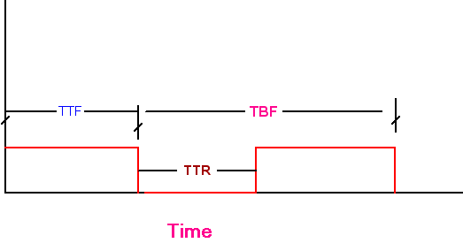
Mean Time Between Failure: MTBF

Slide 33
Reliability (Product Metric)
MTTF (mean time to failure) =
average time between failures = # failures / time
  time in execution time or calendar time
MTBF (mean time between failure) = MTTF + mean time to repair
  to know when your system will be available, take into account repair

Slide 34
Sample Quality Metrics (III)
Correctness (Product Metric)
“a system is correct or not, so one cannot measure correctness”
defect density = # known defects / product size
  product size in LOC or FP
  # known defects is a time based count!
do not compare across projects unless your data collection is sound!

Slide 35
Software Development Process Models

Slide 36
Waterfall Process Model
The bottom line of this approach is to make:
  Large software projects more manageable &
  Delivered on time without cost overrun.

Slide 37
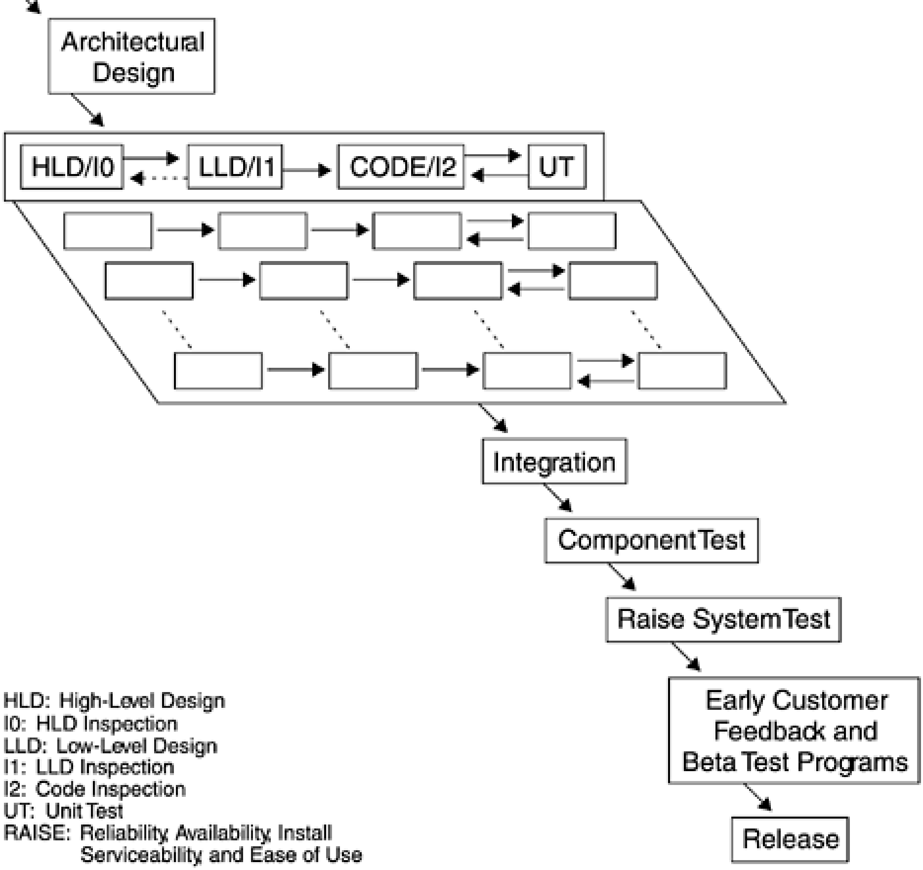

Slide 38
High-Level Design
Develop the external functions and interfaces, including:
  external user interfaces
  application programming interfaces
  system programming interfaces: intercomponent interfaces and data structures.
Design the internal component structure, including intracomponent interfaces and data structures.

Slide 39
HLD
Ensure all functional requirements are satisfied.
Ensure the component fits into the system/product structure.
Ensure the component design is complete.
Ensure the external functions can be accomplished—"doability" of Requirements.

Slide 40
Low-Level Design
Low-level design is the process of transforming the HLD into more detailed designs from the perspective of a part or modules. Its objectives are as follows:
  Finalize the design of components and parts (modules, macros, includes) within a system or product.
  Complete the component test plans.
  Give feedback about HLD and verify changes in HLD.

Slide 41
Code Stage
The coding portion of the process results in the transformation of a function's LLD to completely coded parts. The objectives of this stage are as follows:
  Code parts (modules, macros, includes, messages, etc.).
  Code component test cases.
  Verify changes in HLD and LLD.

Slide 42
Unit Test
Verify the code against the component's:
  high-level design &
  low-level design.
Execute all new and changed code to ensure:
  all branches are executed in all directions,
  logic is correct
  data paths are verified.
  All branches are executed in all directions,
  logic is correct &
  data paths are verified.

Slide 43
Component Test
Test external user interfaces against the component's design documentation— user requirements.
Test intercomponent interfaces against the component's design documentation.
Test application program interfaces against the component's design documentation.
Test function against the component's design documentation.
Test intracomponent interfaces (module level) against the component's design documentation.

Slide 44
Contd…
Test error recovery and messages against the component's design documentation.
Verify that component drivers are functionally complete and at the acceptable quality level.
Test the shared paths (multitasking) and shared resources (files, locks, queues, etc.) against the component's design documentation.
Test ported and unchanged functions against the component's design documentation.

Slide 45
System-Level Test
The system-level test phase comprises the following tests:
  System test
  System regression test
  System performance measurement test &
  Usability tests

Slide 46
Contd…
The system test follows the component tests and precedes system regression tests.
The system performance test usually begins shortly after system testing starts and proceeds throughout the system-level test phase.
Usability tests occur throughout the development process (i.e., prototyping during design stages, formal usability testing during system test period).

Slide 47
System test objectives
Ensure software products function correctly when executed concurrently and in stressful system environments.
Verify overall system stability when development activity has been completed for all products.

Slide 48
System regression test objective
Verify that the final programming package is ready to be shipped to external customers.
Make sure original functions work correctly after functions were added to the system.

Slide 49
System performance measurement test objectives
Validate the performance of the system.
Verify performance specifications.
Provide performance information to marketing.
Establish base performance measurements for future releases.

Slide 50
Usability tests objective
Verify that the system contains the usability characteristics required for the intended user tasks and user environment.

Slide 51
Applicability
Waterfall process model is most appropriate for systems development characterized by a high degree of complexity and interdependency.
Although expressed as a cascading waterfall, parallelism and some amount of iteration among process phases often exist in actual implementation.
The focus should be on the intermediate deliverables (e.g., design document, interface rules, test plans, and test cases) rather than on the sequence of activities for each development phase.

Slide 52
The Prototyping Approach
Gather and analyze requirements.
Do a quick design.
Build a prototype.
Customers evaluate the prototype.
Refine the design and prototype.
If customers are not satisfied with the prototype, loop back.
If customer satisfied, begin full-scale product development.

Slide 53
Prototyping
Quick turnaround in designing and building.
Reusable software parts could make the design and implementation of prototypes easier.
Formal specification languages could facilitate the generation of executable code (e.g., the Z notation and the Input/Output Requirements Language (IORL) (Smith and Wood, 1989).
4 GL and technologies could be extremely useful for prototyping in the graphical user interface (GUI) domain.

Slide 54
Prototyping
Most applicable to small tasks or at the subsystem level.
Prototyping a complete system is difficult.
In practice, the method of time boxing is being used.
This method involves setting arbitrary time limits (e.g., three weeks) for each activity in the iteration cycle and for the entire iteration and then assessing progress at these checkpoints.

Slide 55
Rapid Throwaway Prototyping
The rapid throwaway prototyping approach of software development, made popular by Gomaa and Scott (1981), is now used widely in the industry, especially in application development.
It is usually used with:
  high-risk items or
  with parts of the system that the development team does not understand thoroughly.

Slide 56
Contd…
In this approach, "quick and dirty“ prototypes are built, verified with customers, and thrown away until a satisfactory prototype is reached, at which time full-scale development begins.

Slide 57
Evolutionary Prototyping
A prototype is built based on some known requirements and understanding.
The prototype is then refined and evolved instead of thrown away.
Evolutionary prototypes are likely to be used with aspects of the system that are well understood and thus build on the development team's strengths.
These prototypes are also based on prioritized requirements, sometimes referred to as "chunking" in application development (Hough, 1993).

Slide 58
Spiral Model of Software Development
Developed by Boehm (1988), is based on experience.
Refinements of the waterfall model as applied to large government software projects.
Relies heavily on prototyping and risk management, it is much more flexible than the waterfall model.

Slide 59
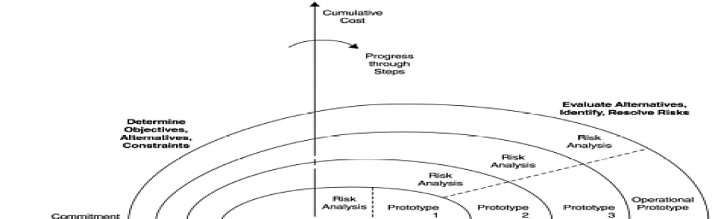
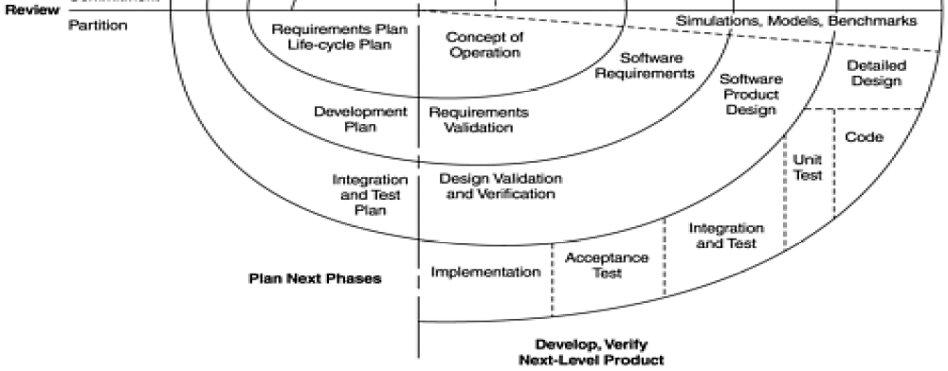

Slide 60
Contd…
Starting at the center of the spiral, each development phase, consists of:
  operation,
  software requirements,
  product design,
  detailed design, &
  Implementation involving one cycle of the spiral.
The angular dimension represents the progress made in completing each cycle of the spiral

Slide 61
Contd…
The first step of each cycle of the spiral is to identify:
  the objectives of the portion of the product being elaborated,
  the alternative means of implementation of this portion of the product &
  the constraints imposed on the application of the alternatives.
The next step is to evaluate:
  the alternatives relative to the objectives & constraints,
  to identify the associated risks, and to resolve them.

Slide 62
Contd…
Risk analysis and the risk-driven approach are key characteristics of the spiral model, in contrast to the document-driven approach of the waterfall model.

Slide 63
Advantages
Accommodates the good features of existing software process models, whereas its risk-driven approach avoids many of their difficulties.
It focuses early attention on options involving the reuse of existing software.
Early identification and evaluation of alternatives is a key step in each spiral cycle.
This model accommodates preparation for life-cycle evolution, growth, and changes of the software product.

Slide 64
Advantages
It focuses on eliminating errors and unattractive alternatives early.
It does not involve separate approaches for software development and software enhancement.
It provides a viable framework for integrating hardware-software system development.

Slide 65
Problems with Spiral Model
Matching to contract software
  The spiral model has a great deal of flexibility and freedom and is, therefore, more suitable for internal software development.
  The challenge is how to achieve the flexibility and freedom prescribed by the spiral model without losing accountability and control for contract software.

Slide 66
Contd…
Relying on risk management expertise
  An inexperienced team may also produce a specification just the opposite
    A great deal of detail for the well-understood, low-risk elements &
    little elaboration of the poorly understood, high-risk elements.
  In such a case, the project may fail and the failure may be discovered only after major resources have been invested.
  Another concern is that a risk-driven specification is people dependent.

Slide 67
Iterative Development Process Model
Domain analysis
Requirements definition
Software architecture
Risk analysis
Prototype
Test suite and environment development
Integration with previous iterations
Release of iteration

Slide 68
Contd…
The development of IBM's OS/2 2.0 operating system is a combination of the iterative development process and the small team approach.

Slide 69
The Cleanroom Methodology
An engineering process with mathematical foundations rather than a trial-and-error programming process (Linger and Hausler, 1992).
The Cleanroom process employs theory-based technologies such as:
  box structure specification of user function and system object architecture,
  function-theoretic design and correctness verification &
  statistical usage testing for quality certification.

Slide 70
Contd…
Based on incremental development and certification of a pipeline of user-function increments that accumulate into the final product.
Operations are carried out by small, independent development and certification (test) teams, with teams of teams for large projects.
The adoption is mostly confined to small projects.

Slide 71
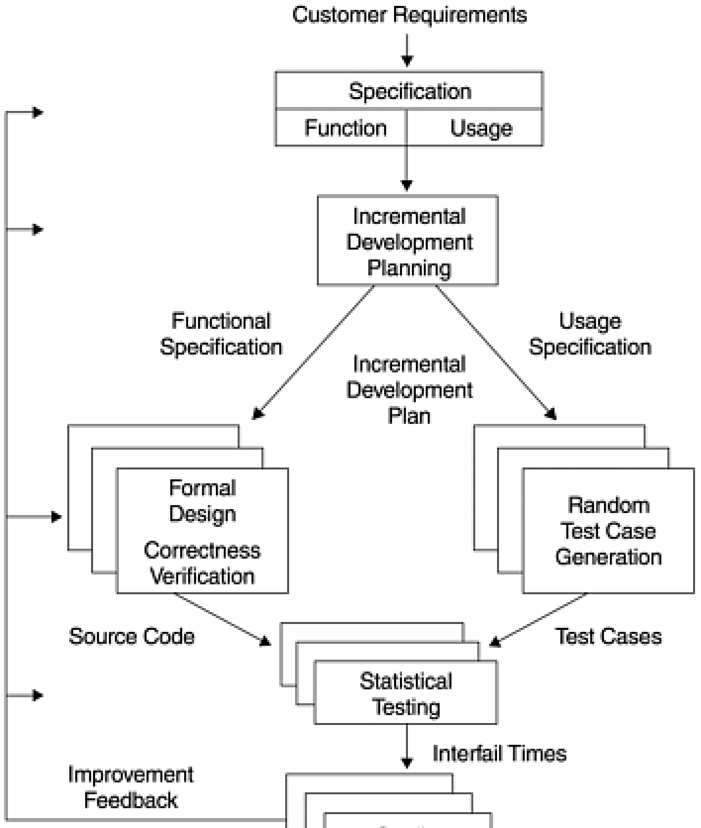

Slide 72
Contd…
The Cleanroom process proclaims that statistical testing can replace coverage and path testing.
All testing is based on anticipated customer usage.
Test cases are designed to rehearse the more frequently used functions.
Therefore, errors that are likely to cause frequent failures to the users are likely to be found first.
In terms of measurement, software quality is certified in terms of mean time to failure (MTTF).

Slide 73
Contd…
The Cleanroom process represents one of the formal approaches in software development that have begun to see application in industry.
Other examples of formal approaches include:
  Vienna Development Method (VDM) and
  Z notation (Smith and Wood, 1989; Wing, 1990).
Z and VDM have been used primarily by developers in the United Kingdom and Europe;
Cleanroom projects are conducted mostly in the United States.

Slide 74
Implementation Frame
Consists of three stages:
Introductory implementation of Cleanroom principles without the full formality of the methodology:
  box structure,
  statistical testing, &
  certification of reliability
Full implementation involves the complete use of Cleanroom's formal methods.

Slide 75
Contd…
Advanced implementation optimizes the process for the local environment like:
  Use of an automated code generator,
  Markov modeling and analysis of system usage, &
  Certification using a locally validated reliability model

Slide 76
The Defect Prevention Process
It is based on three simple steps:
  Analyze defects or errors to trace the root causes.
  Suggest preventive actions to eliminate the defect root causes.
  Implement the preventive actions.

Slide 77
Contd…
DPP can be applied to any development process—waterfall, prototyping, iterative, spiral, Cleanroom, or others.
As long as the defects are recorded, causal analysis can be performed and preventive actions mapped and implemented.
The important role of DPP in software process improvement is widely recognized by the software community.

Slide 78
The SEI Process Capability Maturity Model
The Software Engineering Institute at the Carnegie-Mellon University developed the Process Capability Maturity Model (CMM).
Its a framework for software development (Humphrey, 1989).
The CMM includes five levels of process maturity.

Slide 79
Level 1: Initial
Characteristics:
  Chaotic—unpredictable cost, schedule, and quality performance.

Slide 80
Level 2: Repeatable
Requirements management
Software project planning and oversight
Software subcontract management
Software quality assurance
Software configuration management

Slide 81
Level 3: Defined
Organizational process improvement
Organizational process definition
Training program
Integrated software management
Software product engineering
Intergroup coordination
Peer reviews

Slide 82
Level 4: Managed
Process measurement and analysis
Quality management

Slide 83
Level 5: Optimizing
Defect prevention
Technology innovation
Process change management

Slide 84
Pervasive use of Software Metrics
Pervasive use of software metrics and models is a key characteristic of level 4 maturity, and for level 5 the element of defect prevention is key.

Slide 85
List of Metrics Used
Profiles of software size maintained for each software configuration item over time.
Statistics on software design errors.
Statistics on software code and test errors.
Projection of design errors and comparison between projected and actual numbers.

Slide 86
List of Metrics Used
Projection of test errors and comparison between projected and actual numbers.
Measurement of design review coverage.
Measurement of test coverage.
Tracking of design review actions to closure.
Tracking of testing defects to closure.
Database for process metrics data across all projects.

Slide 87
Contd…
Analysis of review data gathered during design reviews.
Analysis of data already gathered to determine the likely distribution and characteristics of the errors in the remainder of the project.
Analysis of errors to determine their process-related causes.
Analysis of review efficiency for each project.

